Slide 1
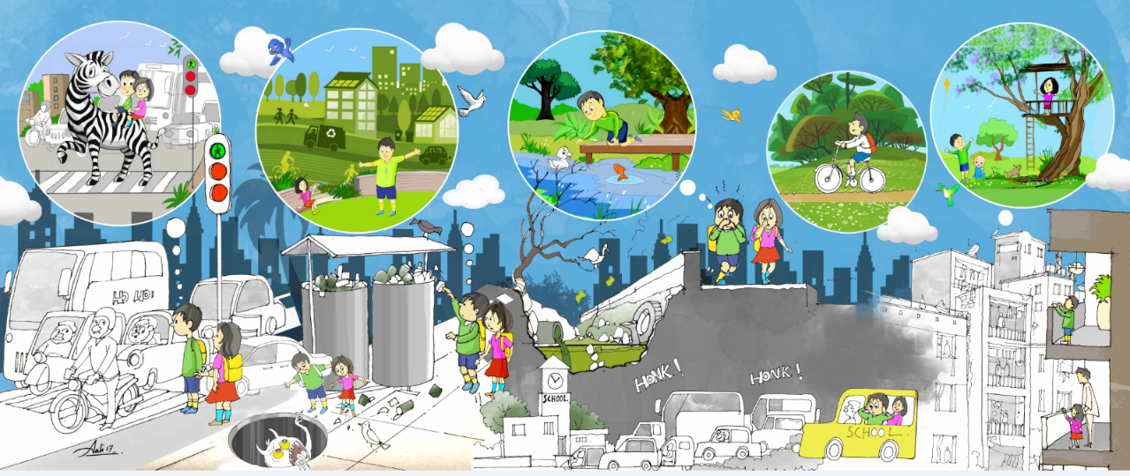
Designing Inclusive Mobility Choices & Accessible Open Play Spaces: Learnings from Bhubaneswar's on-ground experiences
BANKIM KALRA
Team Leader- Urban Planning & Design, IBI Group

Slide 2
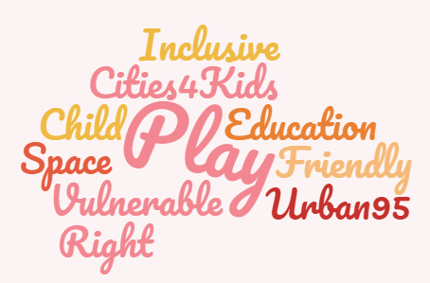

Slide 3
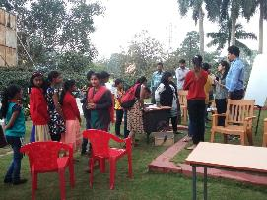
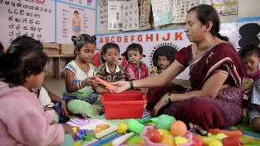
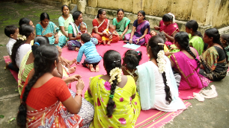
Who is the 'Child' as a Stakeholder?
“Children are a kind of indicator species. If we can build a successful city for children, we will have a successful city for all people.”
- Enrique Penelosa
Youth
Adolescents
SOCIO-ECONOMIC BACKGROUND
AGES
Early Childhood
Youth (14-18)
High Income Neighbourhoods
Adolescents (5-14)
Middle-income Neigbourhoods
Slums
Early Childhood (0-5)

Slide 4
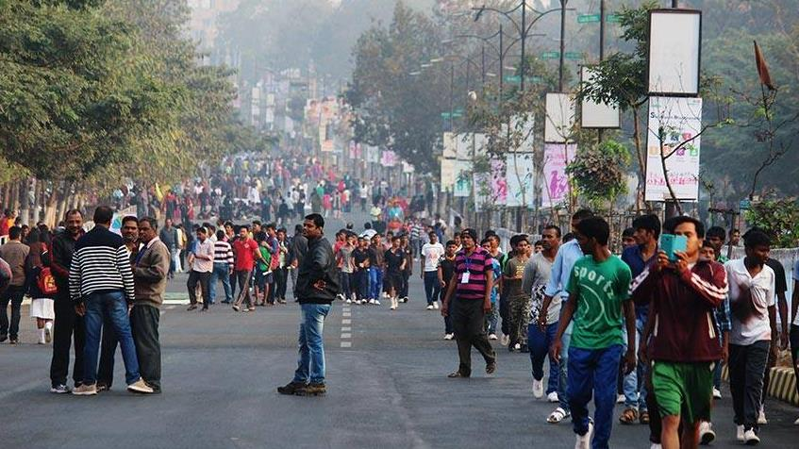
Bhubaneswar Smart City
Vision + Build Basics
TRANSIT ORIENTED CITY
Compact urban form and sustainable mobility choices
LIVABLE CITY
Range of housing while enhancing its heritage
CHILD-FRIENDLY CITY
Accessible, safe, inclusive public places
ECO-CITY
Resilient, clean, green and healthy environment
REGIONAL ECONOMIC CENTRE
Knowledge based enterprises and sustainable tourism
"People- Centric" Planning & Design

Slide 5
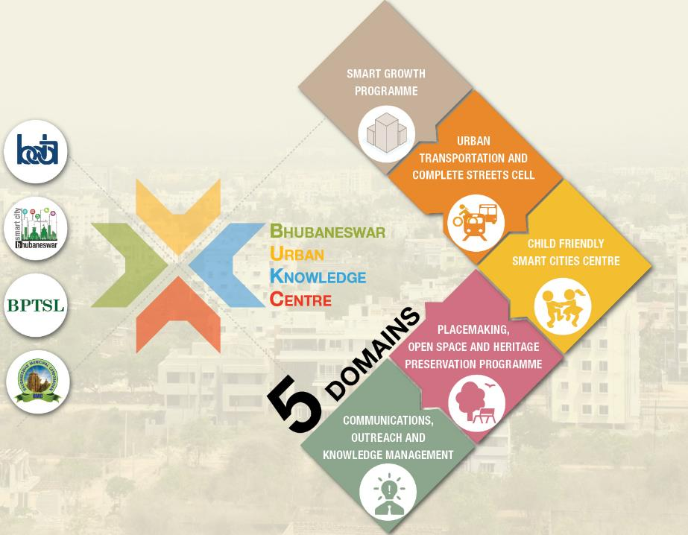
BUKC STRUCTURE
BDA + BvL Foundation + NIUA: Applied Research through CFSC centre in the Bhubaneswar Urban Knowledge Centre (BUKC)
One- Stop City Technical Resource Centre to offer consistent & cohesive technical and analytical inputs to city agencies
Ensure continuous feedback loop for participatory evidence-based planning
Establish Child Friendly Smart City Centre as an Anchor
Notes:
Include BDA | BMC | BSCL | BPTSL logos

Slide 6
ACTIVITIES PROPOSED
Child Friendly Infrastructure
Communication & Knowledge Management
67 Playgrounds @ 1 per ward
12 Traffic Signals near schools
10 Public Kiosks with information panels
10 City Buses
4 redeveloped informal settlements
Press Briefs
Panel Discussions
Website
IEC Campaign
Capacity Building of key government stakeholders
Every year—4 batches
(25 participants)—3days
Child friendly component in planning documents
Disseminating knowledge through workshops
4 Seminars & 2 lectures every year
2 city level and 1 state level consultation
Annual Conference
Form based Urban Codes
Update existing plans
Notes:
Connect with the other 4 domains: reorganize the deliverables

Slide 7
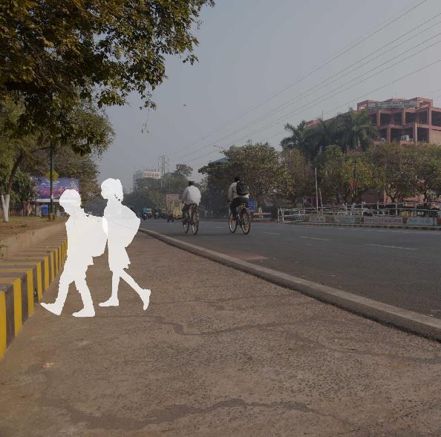
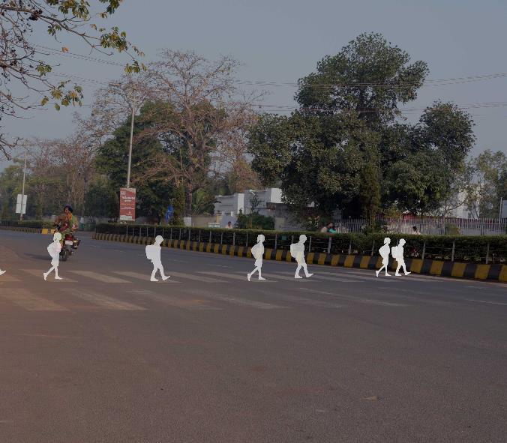
#1: Children’s issues pertaining to mobility in the city
Where are we today?
High Kerb Heights
No provision for midblock

Slide 8
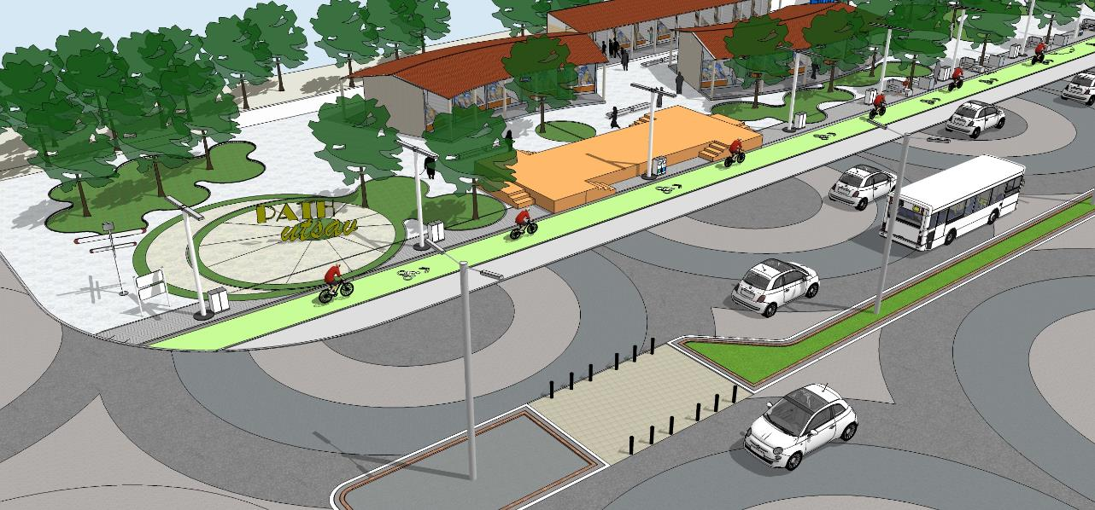
#1: Children’s issues pertaining to mobility in the city
Applied Research- ReImagining Child-Friendly Smart Janpath

Slide 9

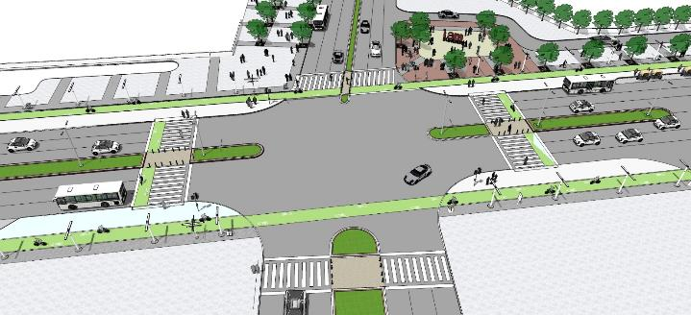
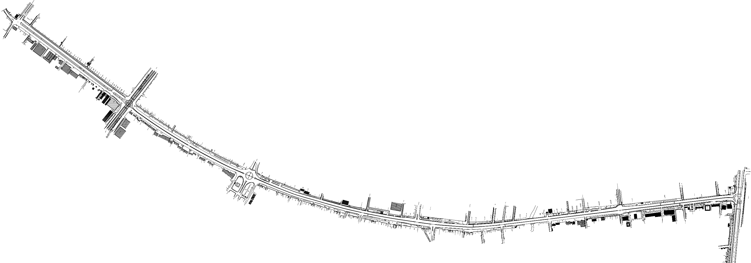
#1: Children’s issues pertaining to mobility in the city
Applied Research- Safe Route to School
Existing School Locations
Child-friendly Crossings
Shishu Babhan
Rajmahal Square
Master Canteen
Shriya Talkies
Vani Vihar
Activity Areas
Signage for School zone
Street vendors near schools for children
Cycles for Children
Ramp for prams
Survey of school going children
Maharishi College
Rupali
Square
Ram Mandir

Slide 10
#1: Children’s issues pertaining to mobility in the city
Applied Research- ReImagining Child-Friendly Smart Janpath

Slide 11
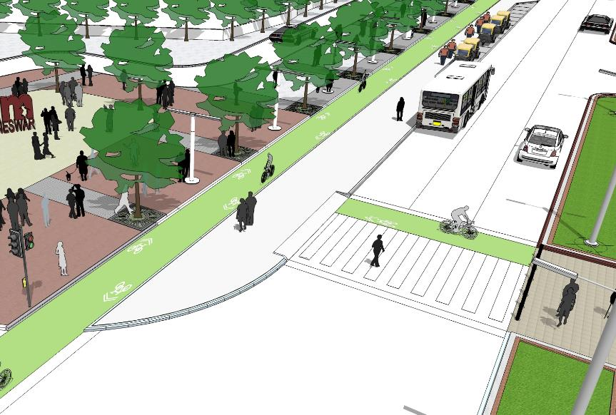
#1: Children’s issues pertaining to mobility in the city
Challenges & Opportunities
Limited Research
Institutional capacities to implement
Hard to change conventional procedures and mindset
Vendor disconnect

Slide 12
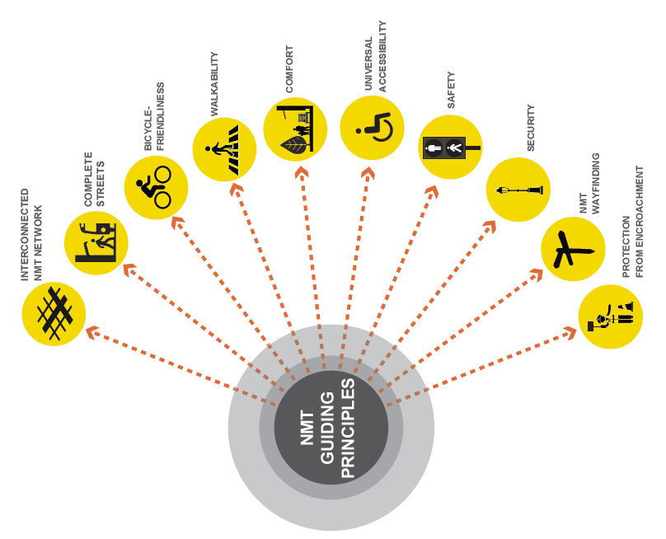
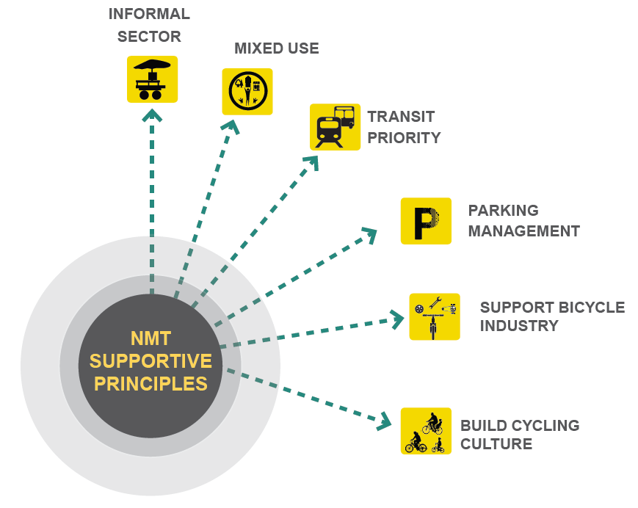
#2: Measures & Indicators to enable child-friendly design interventions
Where are we today?
NMT Guidance Document (MoUD)

Slide 13
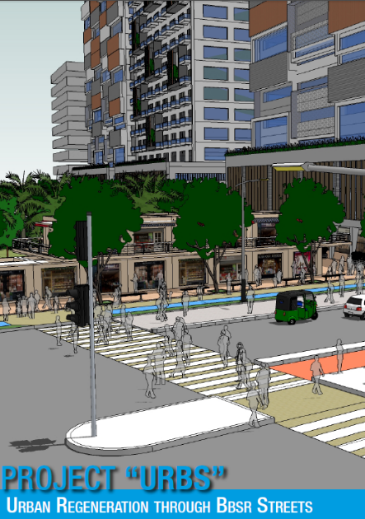
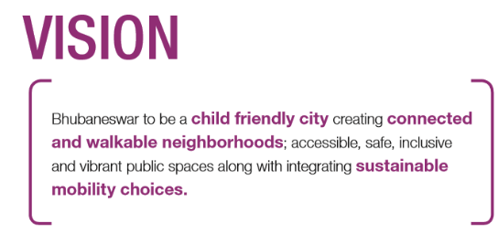
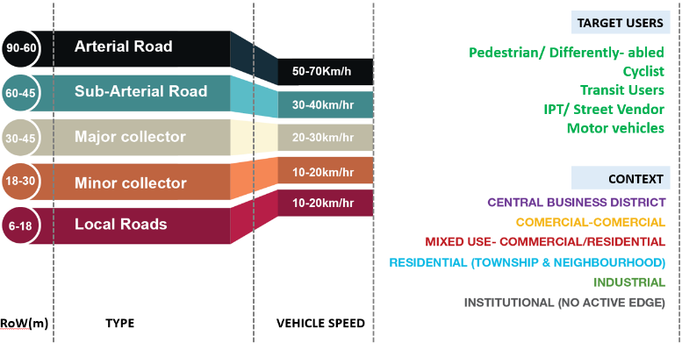
#2: Measures & Indicators to enable child-friendly design interventions
Where are we today?
Inclusion of
Child friendly components

Slide 14
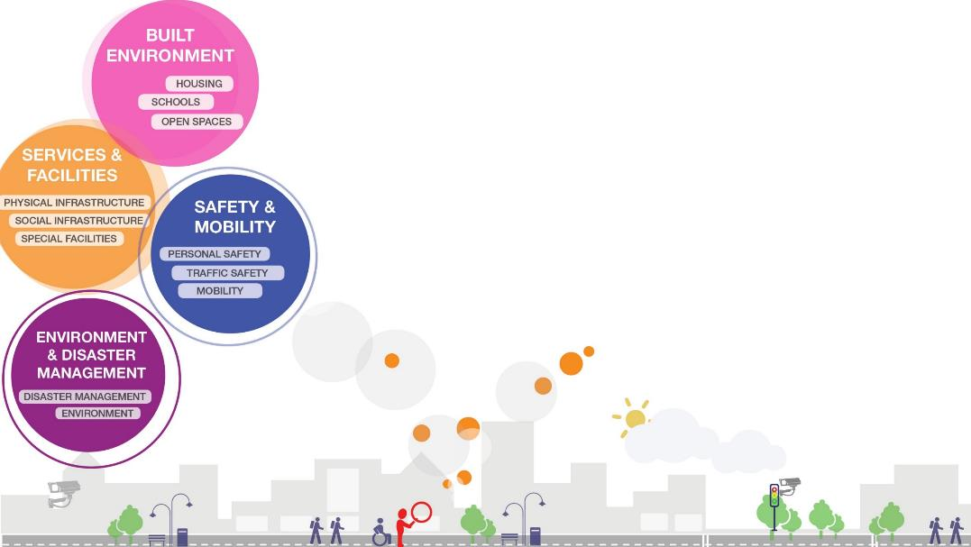
#2: Measures & Indicators to enable child-friendly design interventions
Where are we today?
NIUA ICHILD INDICATORS
Restructuring local decisions to support child-friendly policies, planning and design as one of the catalysts of change in future Bhubaneswar.
RIGHTS BASED APPROACH
ENVIRONMENT BASED APPROACH
“If you could see the city from an elevation of 95 cm – the average height of a healthy 3 year old – what would you do differently?”
-Urban95, BvL Foundation

Slide 15
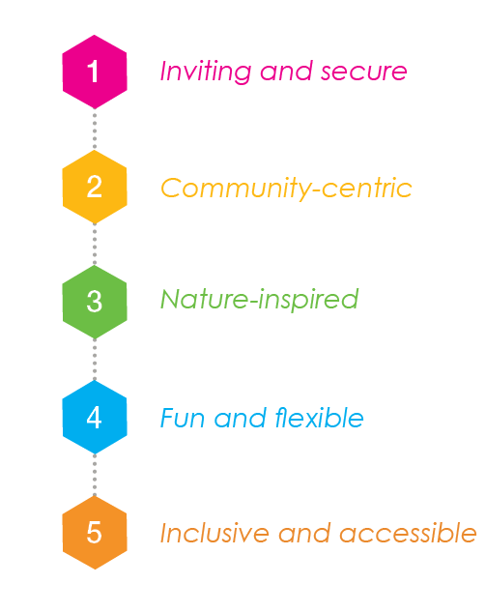

#2: Measures & Indicators to enable child-friendly design interventions
Bhubaneswar Child Friendly Design Guidelines for Parks & Open Spaces

Slide 16
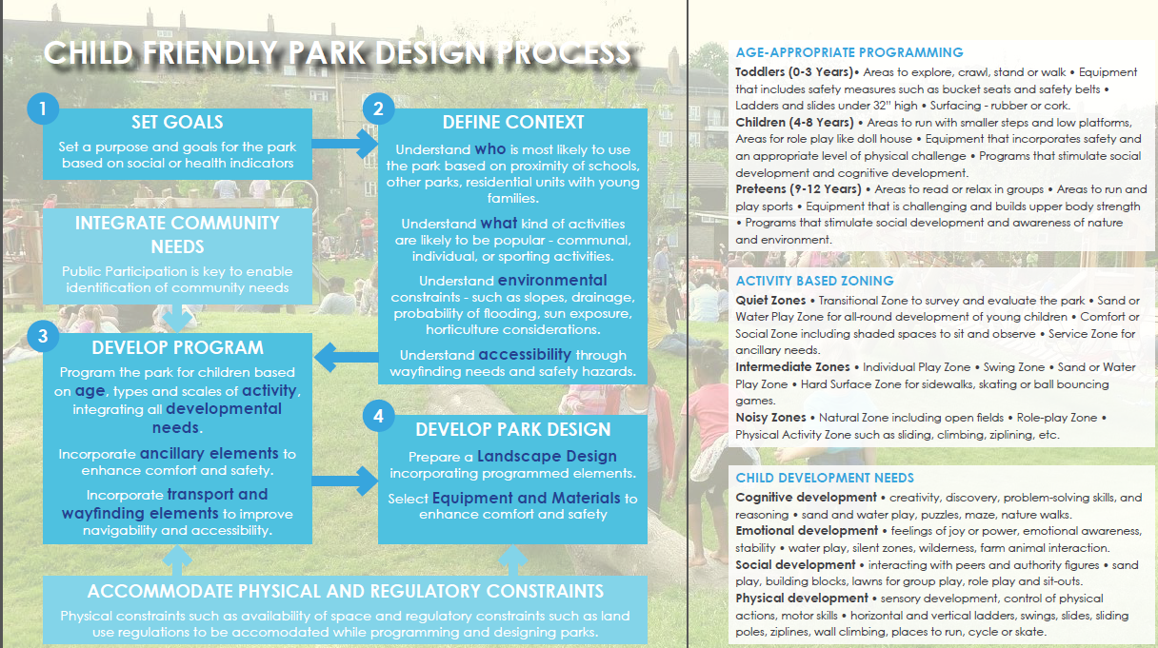
Projects- Child Friendly Park Guidelines

Slide 17
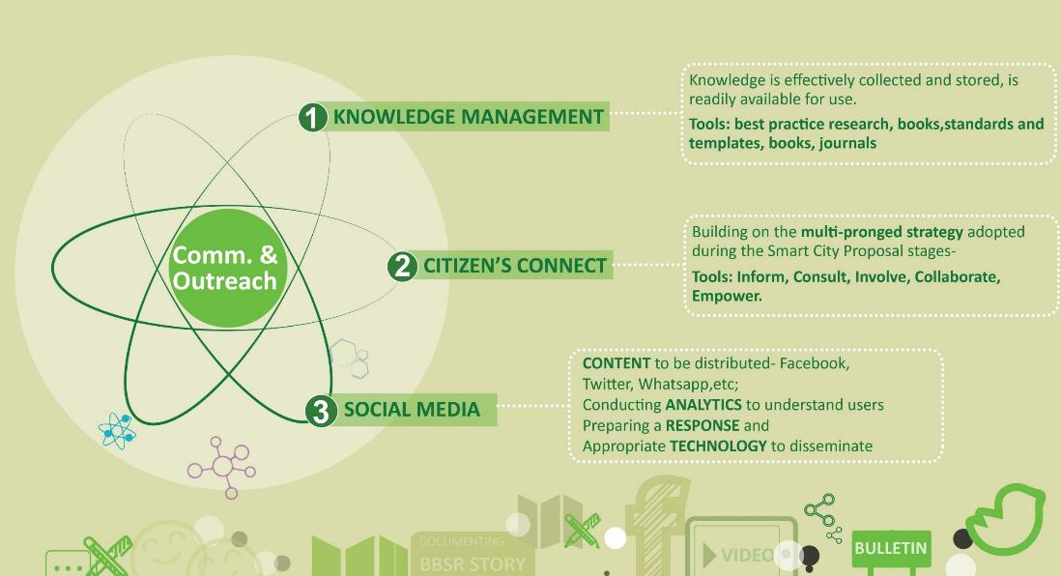
#2: Measures & Indicators to enable child-friendly design interventions
Challenges & Opportunities
Data gap | Industry and academia disconnect | Research culture in ULBs

Slide 18
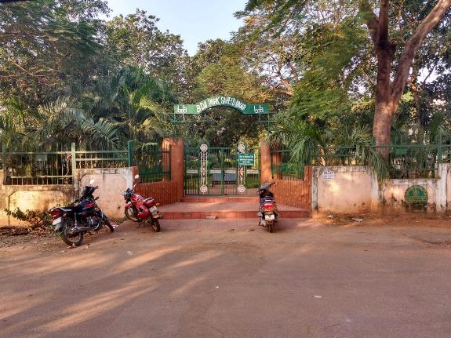
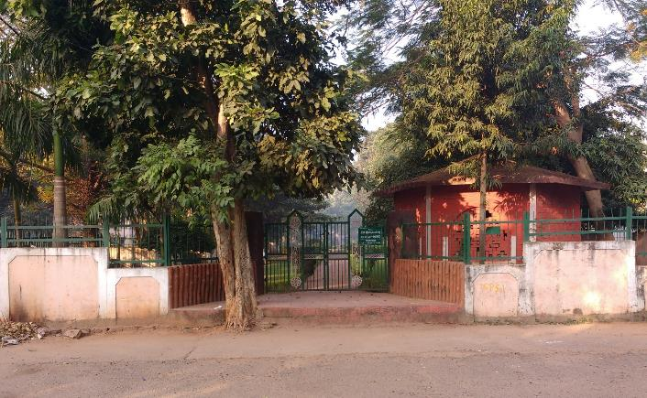
#3: Integrating play space into wider design of public realm in smart cities
Where are we today?
Lacks ease of access for children- Riser height of steps was 17.5 cm to 20 cm

Slide 19
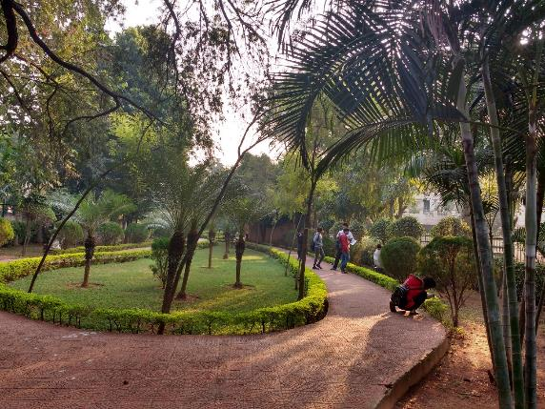
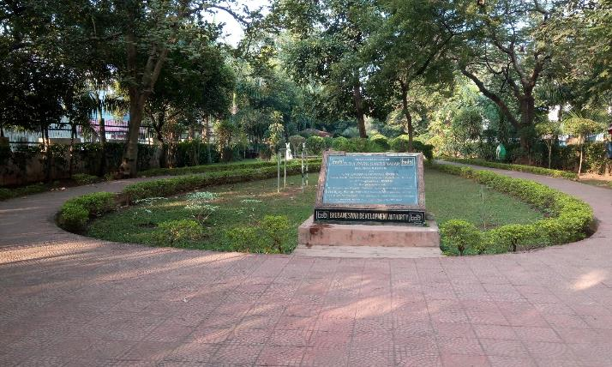
#3: Integrating play space into wider design of public realm in smart cities
Where are we today?
Designed as passive spaces that lack activities for children

Slide 20
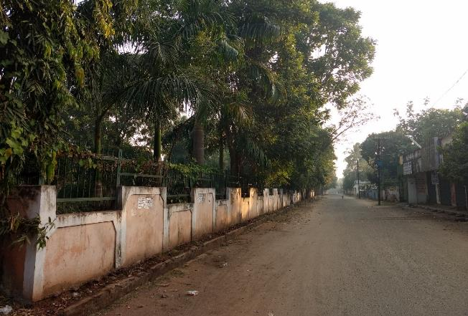
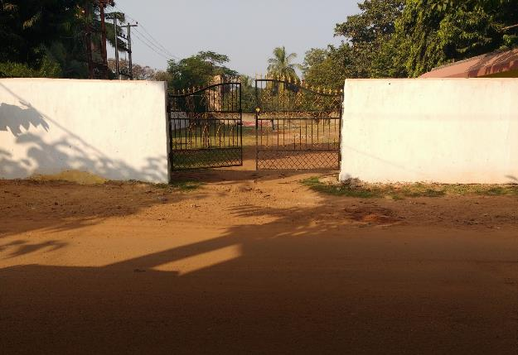
#3: Integrating play space into wider design of public realm in smart cities
Where are we today?
Visually inaccessible with high boundary walls: 8 feet high

Slide 21
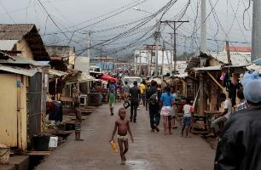
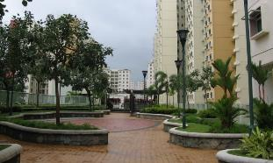
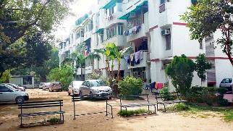
#3: Integrating play space into wider design of public realm in smart cities
Where are we today?
Unregulated Spaces
Gated Communities
SOCIO-ECONOMIC BACKGROUND
Unmanaged Spaces

Slide 22
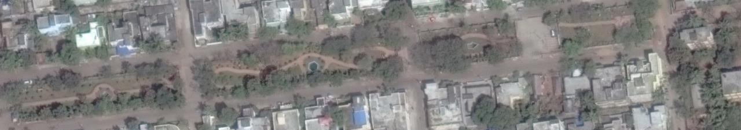
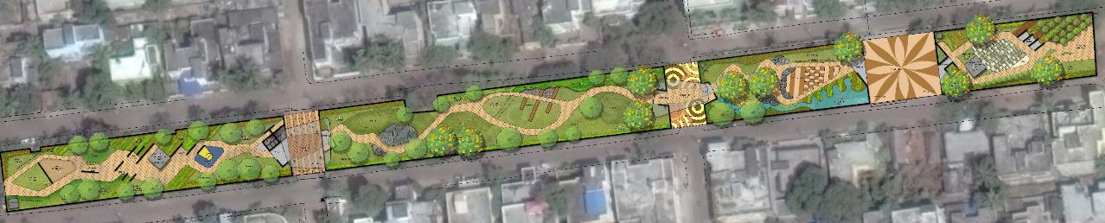
#3: Integrating play space into wider design of public realm in smart cities
Applied Research: CFS Parks
BDA PARK IV
BDA PARK III
BDA PARK II
BDA PARK I

Slide 23
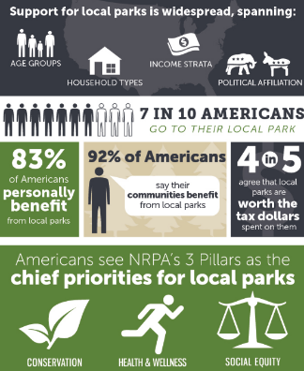
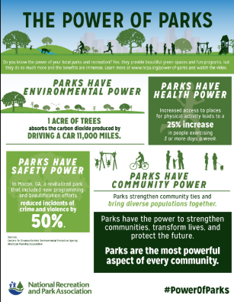

#3: Integrating play space into wider design of public realm in smart cities
Challenges & Opportunities
URDPFI Guidelines & NPRA Standards (U.S.) | Vendor capacities | Financial barriers

Slide 24

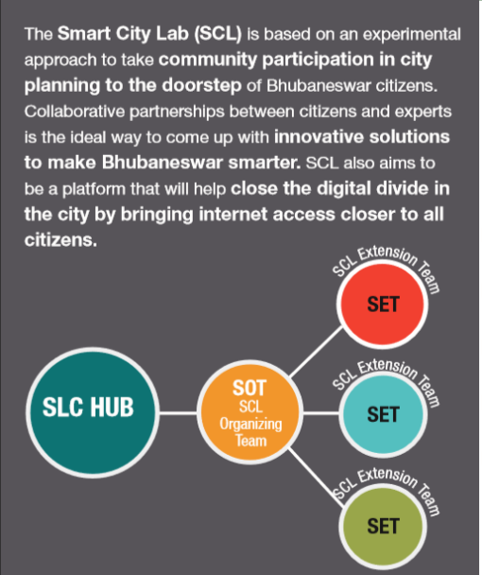
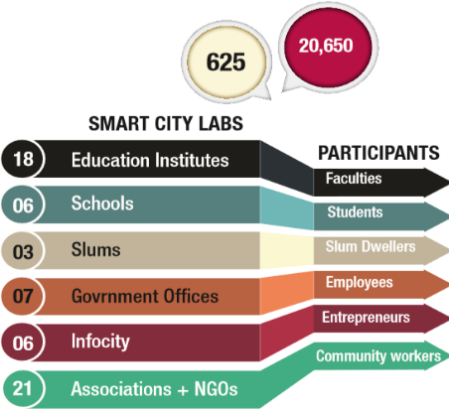
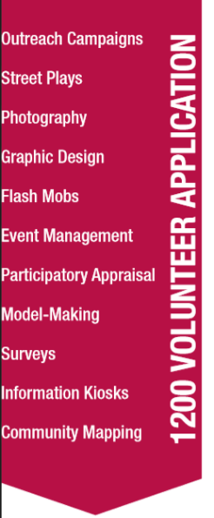


#4: Challenge of recognising and responding to young people as stakeholders
Where are we today

Slide 25
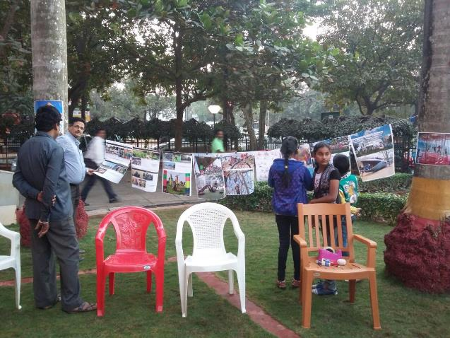
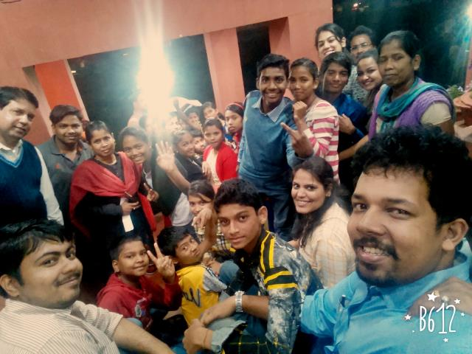
#4: Challenge of recognising and responding to young people as stakeholders
Applied Research
Design Charrettes: CFS Parks

Slide 26
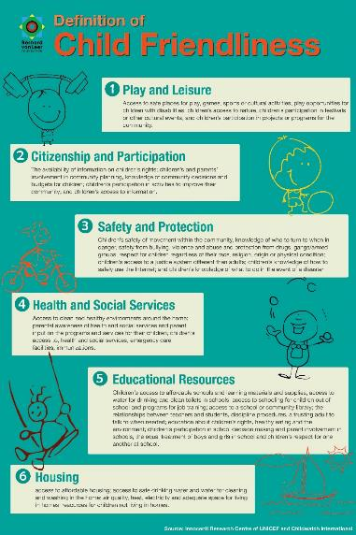
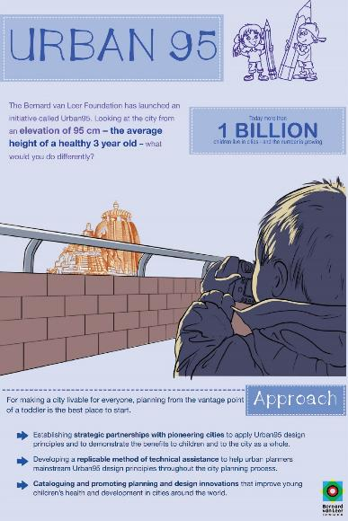
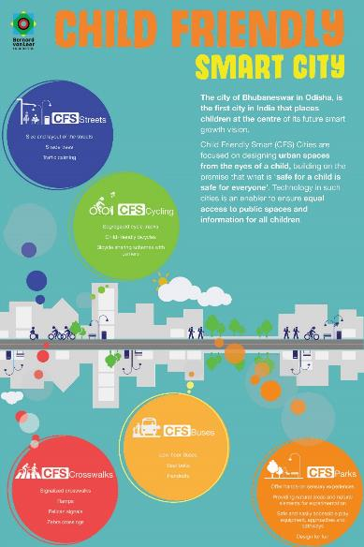
#4: Challenge of recognising and responding to young people as stakeholders
Applied Research
BUKC Communication & Outreach (Creatives)

Slide 27
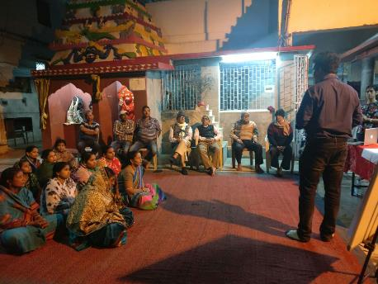
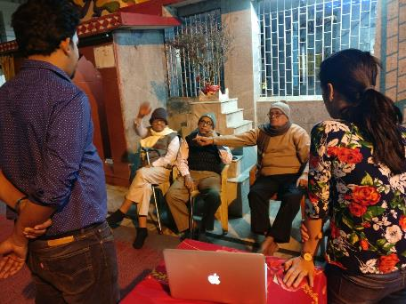
#4: Challenge of recognising and responding to young people as stakeholders
Challenges & Opportunities
Lack of partnerships with educational institutions
Sensitizing residents with more involvement
Digital Divide
Lack of formal outreach programmes (esp. sports)

Slide 28
Thank You

